Slide 1

Mixed Methods Procedures
Describe the six characteristics of mixed methods research.
Create a justification for using mixed methods research in a proposal or study.
Contrast quantitative and qualitative data.
Identify, for a core design, its intent, procedures for data collection, integration, meta‑inferences, and validity.
Choose a type of mixed methods design for a study and present the reasons for the choice.

Slide 2
04/03/2026
Mixed Methods Procedures
What should be considered when “mixing” quantitative and qualitative data?
1.
Both methods provide different types of information
Qualitative data are open data, while quantitative data are closed data.
Integration of methods and data must provide a stronger understanding of the problem or research question than either method alone.
2.
Both methods have strengths and limitations
The goal is to combine the strengths to develop a stronger understanding of the research problem or questions, while overcoming the limitations of each approach.

Slide 3
04/03/2026
Mixed Methods Procedures
Have you defined mixed methods research?
Do you justify the use of mixed methods design for your problem and question?
Have/would you collected/collect both quantitative and qualitative data?
Have you described your intention for collecting both forms of data?
Have you identified a type of mixed methods design or a set of procedures to integrate your data?
Have you provided a diagram of your design procedures?
Have you identified how you will analyse your data for integration?
Have/would you drawn/draw conclusions (or meta‑inferences) from the integrated analysis?
Have you discussed validity and ethics related to your research design?

Slide 4
04/03/2026
Mixed Methods Procedures
1
2
3
4
Characteristics of Mixed Methods Research
Justification for the Use of Mixed Methods
Definitions
Process of Developing a Mixed Methods Study

Slide 5
04/03/2026
Characteristics of Mixed Methods Research
6.
Frames the study with worldviews or theories: these are the beliefs or values of the researcher (worldview) or models (theories) from the literature that frame the entire study.
Frames the study with
worldviews or theories
Draws conclusions,
knowledge, and interpretations
5.
Draws conclusions: knowledge, and interpretations from the analysis, called meta‑inferences.
Analyses the
connection
4.
Analyses the connection by creating a table called a joint display
Uses procedures to
connect the two
types of data
3.
Uses procedures to connect the two types of data: methods for collecting, analysing, and interpreting data, called mixed methods designs.
Connects the
two types of data
2.
Connects the two types of data: “mixing” or joining the two databases, called integration.
Collection of two types of data
1.
Collects two types of data: (a) data from the participants’ perspective (qualitative data) and(b) data from the researchers’ or literature perspective (quantitative data)to study the problem or the research questions.

Slide 6
04/03/2026
Mixed Methods Procedures
1
2
3
4
Characteristics of Mixed Methods Research
Justification for the Use of Mixed Methods
Definitions
Process of Developing a Mixed Methods Study

Slide 7
04/03/2026
Characteristics of Mixed Methods Research
Access to data
Researchers may have access to both quantitative and qualitative data, which allows for additional “mining” of information beyond the results obtained from quantitative or qualitative datasets
A useful addition if you are trained in quantitative research is to collect qualitative data to provide evidence that supports numerical findings.
Problems complexity
For example, research and reporting during the pandemic, where daily statistics on new cases were observed alongside stories of people resisting vaccination.
Added value of combining data
A mixed‑methods perspective provides richer understanding compared with reporting only quantitative or only qualitative results.
1.
Develop a comprehensive understanding of a research problem by combining quantitative and qualitative findings.
2.
Explain quantitative results in more detail using qualitative data.
3.
Improve measures, scales, and instruments by incorporating participants’ perspectives who completed the instruments.
4.
Improve experiments or trials by incorporating individuals’ perspectives.
5.
Evaluate programmes based on the combination of quantitative and qualitative data.
6.
Develop cases or document diverse cases for comparison

Slide 8
04/03/2026
Mixed Methods Procedures
1
2
3
4
Characteristics of Mixed Methods Research
Justification for the Use of Mixed Methods
Definitions
Process of Developing a Mixed Methods Study

Slide 9
04/03/2026
Definitions
Data types
Distinguishing between the two types of data is more specific than simply referring to numbers versus text, or numeric data versus narratives.
Some data sources may contain both closed and open elements, such as health data that include closed scores from medical tests as well as open information from patient histories.
Open data
Closed data
Information collected where the researcher provides No predefined response options, such as rating scales (“strongly agree” to “strongly disagree”).
Applied to qualitative observations and documents, the researcher does not use a predetermined set of response options but rather observes or examines documents to identify meaning.
Information collected where researchers ask a question but do not provide a response option.
.

Slide 10

04/03/2026
Definitions
Designs
Procedure used to carry out a study, extending from broad philosophical assumptions to the interpretation of data.
Evaluation processes
Convergent
Mixed Methods
Basic designs
Case study procedures
Explanatory sequential
Complex designs
Participatory action research frameworks
Exploratory sequential
Experimental processes

Slide 11
04/03/2026
Definitions
Integration
Joint Display (visualisation)
This involves combining or “mixing” quantitative and qualitative data within a study or across a series of studies.
It consists of the reasons or “intent” for combining the two databases/sources and the procedures used to carry out this mixing.
Integration varies depending on the type of mixed methods design. In terms of procedures:
The researcher merges or combines the two databases
The researcher connects them, allowing one to build upon the other.
For complex designs, integration involves incorporating one or more basic designs into a broader process or framework, such as an experiment, evaluation, or participatory action‑research project.
In procedures that involve combining data, the researcher needs some way of examining the effect of bringing the two databases together.
A joint display is a table or chart that presents the side‑by‑side combination of the two databases.
Joint displays vary across different designs, because the procedures for combining data differ depending on the design.
Meta‑inference
As the joint display table or chart is examined, conclusions are drawn about the understanding that emerges from comparing the two databases.
In mixed methods, these insights are called meta‑inferences, meaning that a researcher reaches quantitative and qualitative conclusions and then draws additional inferences beyond what each method provides on its own.

Slide 12
04/03/2026
Mixed Methods Procedures
1
2
3
4
Characteristics of Mixed Methods Research
Justification for the Use of Mixed Methods
Definitions
Process of Developing a Mixed Methods Study

Slide 13
04/03/2026
The process
The process of conducting a mixed methods study involves connecting quantitative and qualitative data with a specific type of mixed methods design.
Draws a diagram of the design
Integrates the two databases
Presents the integration in a joint table or visualization for analysis
Derives insights or meta‑inferences from the results of the integration
Data collection
After defining the methodology with key characteristics and a justification for its use, it is necessary to specify the types of qualitative and quantitative data collected.
A useful strategy is to pose a general problem for the mixed methods study and gather two types of data (quantitative and qualitative) to address the issue of interest (i.e., benefits of having both open and closed information simultaneously).
To merge the two databases during integration, it is necessary to have a clear idea of the types of data collected.
⚠️You must state:
The source of each type of data (e.g., attitude instrument, interview)
The number of people, observations or documents collected
Specific details about the sources (e.g., the instrument and specific scales, the online interviews).

Slide 14

04/03/2026
The process for central designs
Convergent (one‑phase design)
Collection of quantitative data
Merging of results
Interpretation of results
Collection of qualitative data
Explanatory sequential (two‑phase design)
Creswell
(2018)
Identification
of results
Interpretation
of results
Collection of quantitative data
Collection of qualitative data
How does
the qualitative
e explain the
quantitative?
Phase 1
Phase 2
Creswell and Plano Clark identified three basic mixed methods designs: the convergent design, the explanatory sequential design, and the exploratory sequential design.
Exploratory sequential (three‑phase design)
Identification of
an attribute
for testing
Interpretation
of results
Collection of qualitative data
Quantitative testing of the attribute
How does
the testing improve our results?
Phase 1
Phase Phase 2
Phase 3

Slide 15
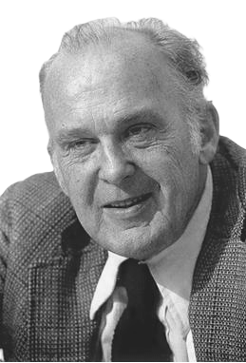
04/03/2026
Convergent (one‑phase design)
Collection of quantitative data
Merging of results
Interpretation of results
Collection of qualitative data
Key assumption:
Qualitative data and quantitative data provide different types of information, and their patterns/results are expected to converge.
Detailed views from participants (qualitative)
Scores on instruments (quantitative)
When comparing the results, the additional purpose is to assess whether the findings:
Converge (match) or diverge
Mutually support a construct
Validate one form of data with the other
The goal of the convergent design is to compare the results of the qualitative database with those of the quantitative database by merging the results.
1.
Collect quantitative and qualitative data
2.
Analys the data separately
3.
Compare the results to see whether the findings confirm or disconfirm each other
Ideally, both forms of data should be collected using the same variables, constructs, or concepts.
Based on the historical concept of the idea of multiple methods and multiple traits Campbell and Fiske (1959) suggested understanding a psychological trait by collecting different forms of data.
Measurement of the concept of self‑esteem:
During quantitative data collection, questions are asked about the same concept that is also explored during the qualitative data collection process.
Campbell y Fiske (1959)

Slide 16
04/03/2026
Convergent (one‑phase design)
Collection of quantitative data
Merging of results
Interpretation of results
Collection of qualitative data
Sampling
Typically, mixed methods researchers include the qualitative participant sample within the larger quantitative sample. Ultimately, the researchers compare the two databases, and the more similar they are, the better the comparison will be.
Integration
Side‑by‑side comparison
These comparisons appear in the discussion sections of mixed methods studies.
1.
Report the quantitative statistical results.
2.
Discuss the qualitative findings (e.g., themes) that confirm or disconfirm the statistical results.
Data analysis process
1.
Analyse the qualitative database by coding the data and collapsing the codes into broad themes.
Themes‑to‑variables / data transformation
Merge the two databases by changing or transforming qualitative codes or themes into quantitative variables and then combine the two quantitative databases.
2.
Analyse the quantitative database in terms of statistical results.
3.
Conduct a mixed methods data analysis of the integration of the two databases. The mixed methods data analysis can be called integration analysis.
Graphical representation
Merge the two forms of data into a table or graphic. This table or graphic is called a joint display.

Slide 17
04/03/2026
Convergent (one‑phase design)
Collection of quantitative data
Merging of results
Interpretation of results
Collection of qualitative data
Graphical representation – Joint display
Quantitative scores | Theme 1 | Theme 2 | Theme | Theme 4 | Meta inferences
High | Cite/Punctuations | Cite/Punctuations | Cite/Punctuations | Cite/Punctuations | Insight
Median | Cite/Punctuations | Cite/Punctuations | Cite/Punctuations | Cite/Punctuations | Insight
Low | Cite/Punctuations | Cite/Punctuations | Cite/Punctuations | Cite/Punctuations | Insight
Meta inferences | Insight | Insight | Insight | Insight | Insight
1.
Add a column and a row for meta‑inferences to the themes and scores. This allows results to be obtained by examining rows or columns containing qualitative and quantitative data.
How do the scores of individuals with high, medium, and low scores differ for Theme 1?
How do individuals with high scores differ across the four themes?
2.
Examine both databases and draw conclusions or insights from the analysis.
4.
Relate these findings to existing literature and/or explain how the meta‑inferences inform theories.
3.
Look for types of integrative results, such as whether the qualitative and quantitative results:
Provide confirmation (agreement)
Show discordance (disagreement).

Slide 18

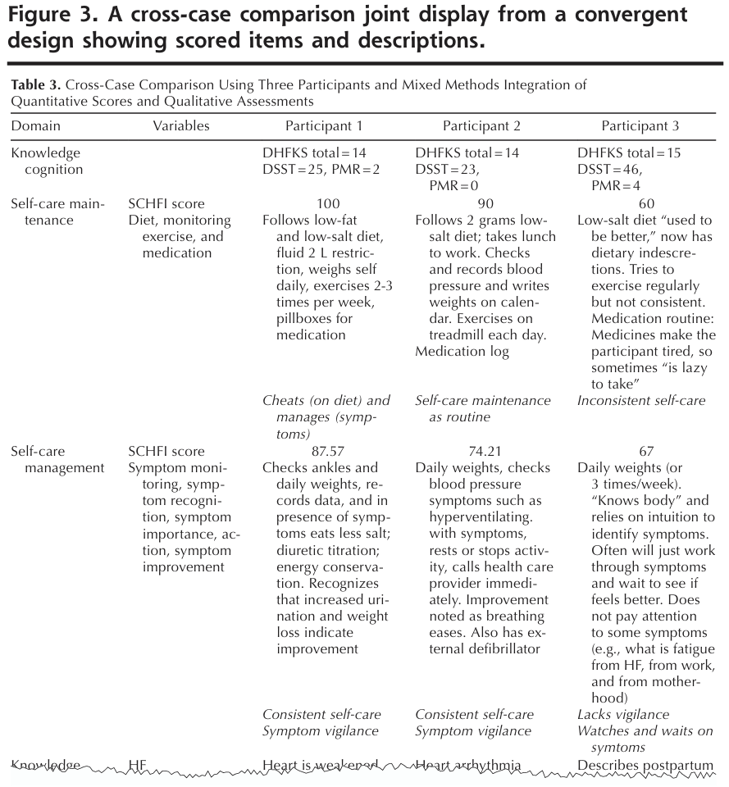
04/03/2026
Convergent (one‑phase design)
Collection of quantitative data
Merging of results
Interpretation of results
Collection of qualitative data
Dickson et al. (2011) investigated how cognitive function and knowledge affected self‑care in heart failure, using a convergent design.
Guetterman et al., (2015)
Dickson et al. developed a joint display comparing cases to compare interview data with quantitative scales of self‑care, cognitive function, and knowledge.
In two specialised outpatient heart‑failure clinics in a large urban medical center in the United States, they administered standardized instruments to measure self‑care, knowledge, and cognitive function
They simultaneously conducted interviews with patients to understand their self‑care practices.
The integration focused on the concordance between the qualitative and quantitative results
The visualisation contained one row for each qualitative domain (theme) and reported the quantitative variables corresponding to that domain.
The participants were arranged in columns.
Inside each cell were the actual quantitative scores as well as summaries and qualitative quotations for each theme–participant combination.
In this example, the authors used the visualisation to validate the quantitative scores for knowledge and self‑care, while also identifying cases of inconsistencies.

Slide 19

04/03/2026
The research in
central designs
When divergence occurs, the researcher needs to conduct a follow‑up analysis.
Divergence may be declared as a limitation in the study without additional follow‑up. However, this approach represents a weak solution.
The researcher may return to the analyses and explore the databases more deeply.
What to do when divergence is identified?
The researcher may gather additional information to resolve the differences or discuss limitations in one of the databases (e.g., invalid quantitative constructs or a poor correspondence between the open-ended question and the qualitative themes).

Slide 20
04/03/2026
Explanatory Sequential (two‑phase design)
Identification
of results
Interpretation
of results
Collection of quantitative data
Collection of qualitative data
How does
the qualitative
e explain the
quantitative?
Phase 1
Phase 2
Key assumption:
Quantitative results may produce unexpected, unusual, significant, or atypical findings, or demographic patterns that require additional explanation.
The qualitative follow‑up phase provides this explanation.
The qualitative data collection is directly based on the quantitative findings.
Data analysis process
1.
Collection of qualitative data to explain the quantitative results in greater detail
2.
The quantitative results typically inform:
Sampling
Procedures must occur over time:
Which participants are purposively selected for the qualitative phase
Which questions are asked in the qualitative interviews
1.
Quantitative sampling (Phase 1)
2.
Purposive qualitative sampling (Phase 2)
The qualitative sample should be a subset of the quantitative sample. Researchers must anticipate the qualitative phase early, even before fully completing the quantitative phase.

Slide 21
04/03/2026
Explanatory Sequential (two‑phase design)
Identification
of results
Interpretation
of results
Collection of quantitative data
Collection of qualitative data
How does
the qualitative
e explain the
quantitative?
Phase 1
Phase 2
Graphical representation – Joint display
Quantitative scores | Qualitative follow‑up themes | Meta‑inferences
High | Theme 1, Theme 2, Theme 3 | How the themes explain the scores
Median | Theme 3, Theme 4 | How the themes explain the scores
Low | Theme 5 | How the themes explain the scores
In an explanatory sequential design, the qualitative sample is a subset of the quantitative sample, leading to overlapping samples; the integration is achieved by connecting Phase 1 results to guide Phase 2 data collection, rather than by a post‑hoc side‑by‑side comparison.
1.
Separate analysis of quantitative and qualitative data.
2.
Connect the databases when the quantitative results guide the qualitative data collection (integration point). This can be done with a joint display. The template for this design shows:
Columns for the quantitative scores
Columns for the qualitative follow‑up themes, which are based directly on the quantitative results.
The joint display, read left to right, follows the order of procedures in the design.
3.
Identify the meta-inferences rather than confirmation or agreement, the conclusions represent an extension of the quantitative results.
The results can help design future quantitative evaluations.
The findings must be compared with existing literature and theories

Slide 22
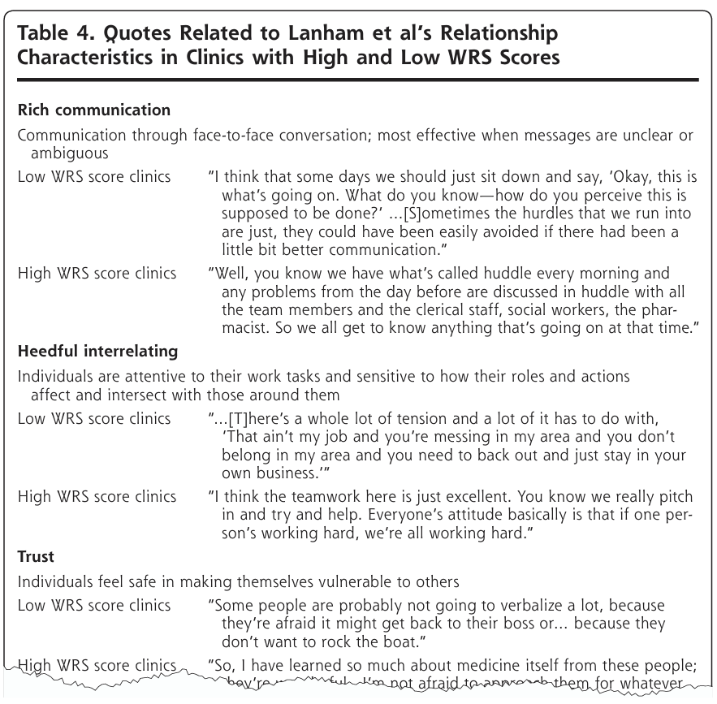
04/03/2026
Convergent (one‑phase design)
Identification
of results
Interpretation
of results
Collection of quantitative data
Collection of qualitative data
How does
the qualitative
e explain the
quantitative?
Phase 1
Phase 2
Finley et al. (2013) carried out an explanatory sequential study with the aim of validating the Work Relationships Scale (WRS) for primary‑care clinics. They analysed the measurement properties of the WRS and correlations with patients’ ratings of quality of care
Guetterman et al., (2015)
They interviewed key informants about relationships in the clinics and analysed the interviews based on the seven characteristics of the WRS.
They concluded that the interview data supported the statistical analysis, providing evidence of validity for the WRS and indicating the importance of relationships in delivering primary care.
They developed a joint display of statistics by themes that compared clinics with low and high WRS scores
The visualisation had a row for clinics with low WRS with a representative quotation, and then a row for clinics with high WRS with a representative quotation.
The headings organised the results according to the theoretical model of work relationships.

Slide 23
04/03/2026
The research process
in central designs
As in all mixed methods studies, the researcher needs to establish the validity of the quantitative measure scores and the qualitative findings.
The precision of the overall findings can be compromised because the researcher does not consider and weigh all the options for following up on the quantitative results.
Attention may focus only on personal demographics, overlooking important explanations that require deeper understanding.
The researcher may also contribute to invalid results by relying on different samples in each phase of the study.
If the goal is to explain the quantitative results in greater depth, it makes sense to select the qualitative sample from among the individuals who took part in the quantitative sample.

Slide 24
04/03/2026
Exploratory Sequential (three‑phase design)
Identification of
an attribute
for testing
Interpretation
of results
Collection of qualitative data
Quantitative testing of the attribute
How does
the testing improve our results?
Phase 1
Phase Phase 2
Phase 3
Key assumption:
We assume that qualitative data can improve (and make contextualised) quantitative measures, scales, or instruments.
Data analysis process
1.
Collect qualitative data
Develop a survey instrument or questionnaire because none exists in the literature.
Develop new variables not present in the literature.
2.
Connect the qualitative findings with a phase of designing quantitative instruments (context‑sensitive), or variables not available in the literature (and adapt them to a specific context).
Modify the types of scales that may exist in current instruments.
Form categories of information explored more deeply in the quantitative phase.
Quotations → to write survey items
Sampling
Codes → to develop variables grouping those items
Should individuals in the qualitative sample also be individuals in the quantitative sample?
No. The qualitative sample is typically much smaller than the quantitative sample needed to generalise to a population. However, a good procedure is to draw both samples from the same population but ensure that the individuals in each sample are not the same.
Themes → to create scales grouping the codes
3.
Test the instrument using sampling/quantitative designs.

Slide 25
04/03/2026
Exploratory Sequential (three‑phase design)
Identification of
an attribute
for testing
Interpretation
of results
Collection of qualitative data
Quantitative testing of the attribute
How does
the testing improve our results?
Phase 1
Phase Phase 2
Phase 3
Graphical representation – Joint display
Qualitative insights | Qualitative follow‑up themes | Meta‑inferences
Quotations | Items of the quantitative survey | Analyze survey scores/indicators
Codes | Variables of the quantitative survey | Identify variables
Themes | Scales of the quantitative survey | Identify scales
2.
Design of attributes / instruments
1.
Separate analysis of the quantitative and qualitative data, using the findings from the initial exploratory qualitative database to construct a characteristic for the quantitative analysis.
Integration in this design involves using qualitative findings (or results) to inform the design of a quantitative phase of the research.
3.
Implementation of the quantitative stage
4.
Development of meta‑inferences. examine the qualitative characteristics and the design characteristics to test the adapted quantitative evaluation.
How well has the adaptation occurred?
Is the modified or newly designed survey producing good results?
Will the test show sensitivity to the sample and population under study?

Slide 26
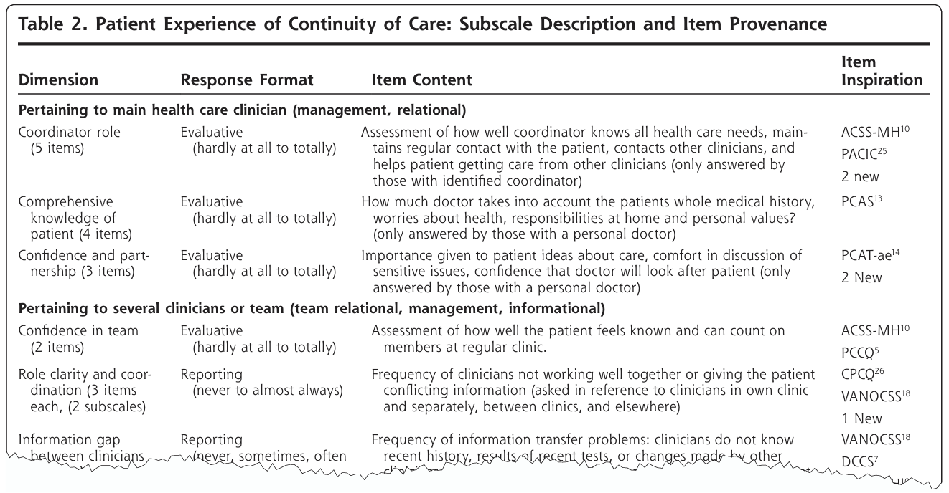
04/03/2026
Exploratory Sequential (three‑phase design)
Identification of
an attribute
for testing
Interpretation
of results
Collection of qualitative data
Quantitative testing of the attribute
How does
the testing improve our results?
Phase 1
Phase Phase 2
Phase 3
Haggerty et al (2012) carried out a sequential exploratory design to develop and validate an instrument that evaluates the continuity of care from the patients’ perspective. They examined themes from 33 qualitative studies on patient‑care experiences.
Guetterman et al., (2015)
The main row headings marked each dimension of continuity of care.
A joint display for instrument development mapped the qualitative dimensions of continuity of care to the items of the quantitative instrument.
The columns provided the response format, a description of the item content, and the source of the item (i.e., existing survey or new item).
By presenting each qualitatively derived dimension together with the corresponding instrument item, the display clearly showed how the instrument was systematically developed.

Slide 27
04/03/2026
The research process
in central designs
As in all mixed methods studies, the researcher needs to establish the validity of the quantitative measure scores and the qualitative findings.
Failure to use the appropriate steps to develop a good psychometric instrument.
Development of an instrument or measures that do not make full use of the richness of the qualitative findings.
The sample in the qualitative phase should not be included in the quantitative phase, because this would introduce undue duplication of responses.
Therefore, this sampling strategy differs from the sampling strategy needed for an explanatory sequential design.

Slide 28
04/03/2026
Definitions
Designs
Procedure used to carry out a study, extending from broad philosophical assumptions to the interpretation of data.
Evaluation processes
Convergent
Mixed Methods
Basic designs
Case study procedures
Explanatory sequential
Complex designs
Participatory action research frameworks
Exploratory sequential
Experimental processes

Slide 29
04/03/2026
The research process in
complex designs
Mixed Methods Experimental Design
Integration of qualitative and quantitative data
This design allows the researcher to collect and analyse both qualitative and quantitative data within the same study.
Methods
Experiment with an interview and pre‑ and post‑test measures
Qualitative data are integrated at different points of the experiment to capture participants’ personal experiences.
This enriches the analysis and provides a more complete understanding of the phenomenon.
Support for experimental data collection
Qualitative data support the pre‑test and post‑test measurements of the experiment
Qualitative interviews before the experiment
(exploratory sequential)
Qualitative interviews during the experiment
(convergent)
Qualitative interviews after the experiment
(explanatory sequential)
By adding qualitative data, researchers can obtain a deeper understanding of how and why participants respond in certain ways to the quantitative tests, helping interpret the results more effectively.
Different forms of integration
Qualitative data may be added before, during or after the experiment.
Recruitment of participants
Development of applicable interventions
Development of pre‑test and post‑test measures
Examination of participants’ experiences
Modifications to the treatment
Examination of the results
Modifications to the experiment
Before → qualitative data help design the intervention and understand participants’ initial context.
During → qualitative data provide real‑time information about implementation and participant experience.
After → qualitative data help interpret results and explore long‑term impact and sustainability.

Slide 30
04/03/2026
The research process in complex designs
Mixed Methods Case Study Design
In this design, the researcher integrates a central design within the broader process of developing case studies for analysis.
The central design is a convergent design
The process consists of developing cases inductively for their description and comparison.
Deductive approach
The cases are established at the beginning of the study.
Differences between the cases are documented through qualitative and quantitative data.
Inductive approach
The researcher collects and analyses both types of data.
Cases are formed during the research process based on the evidence gathered.
Description and Comparison of Cases
Describing each case
Then discussing the similarities and differences between cases
Challenges in Case Identification and Understanding
Identifying the cases before the study begins
Generating cases based on the evidence collected
Quantitative survey
Qualitative interview
Data analysis
Data analysis
Case selection criteria
Interpretation
Interpretation
Case description and themes (Case 1)
Case description and themes (Case 2)
Case description and themes (Case 3)
Comparison between cases and interpretation

Slide 31
04/03/2026
The research process in complex designs
Participatory Action Research Design in Mixed Methods
Active community participation
Community members actively participate in the research. They collaborate closely with researchers throughout the entire research process.
Focus on social change
Social‑justice studies aim not only to gather data but also to promote significant social change and actions that improve people’s lives. This approach goes beyond data collection and focuses on meaningful, concrete actions for the community.
Collaborative evaluation process
Community diagnosis
Monitoring, implementation, and improvement
Collection of mixed data from community members
Mixed
methods core design
Evaluation, collection, and analysis of mixed‑data sources
Planning and selection of a tailored model
An evaluation to diagnose the community’s needs
Data collection through community assessments
Identification and implementation of a model that meets those needs
Implementation of a new model
Continuous evaluation of the model’s success

Slide 32
04/03/2026
The research process in complex designs
Mixed Methods Evaluation Design
Integration: Building from a qualitative evaluation toward theory
Integration of quantitative and qualitative data
This design combines quantitative and qualitative data within an evaluation framework to provide a more complete and detailed understanding of the programme, experiment, or policy being evaluated.
Central designs
Across these projects, multiple central designs are often used.
Evaluation of needs
Qualitative phase
Interviews
Observations
Documents
Theory contextualization
Quantitative phase
Development of instruments and measures
Quantitative phase
When evaluating a programme, it is possible to begin by collecting qualitative data in a needs assessment.
Based on this assessment, a conceptual model is specified and instruments are developed.
Sequential exploratory design
The programme is then implemented and tested, followed by a qualitative follow‑up phase to refine the programme.
Implementation and evaluation
Quantitative phase
Experimental intervention based on quantitative measures
Follow‑up
Qualitative phase
Interviews
Observations
Documents
Combining exploratory and explanatory approaches
It is possible to use multiple central designs.
Moving from a needs assessment to theoretical conceptualisation requires combining qualitative data with a quantitative evaluation in a sequential exploratory design.
Sequential explanatory design
integration
After implementing and quantitatively testing the programme, a qualitative follow‑up phase (or the integration of a sequential explanatory design) is added.

Slide 33

04/03/2026
The research process
in central designs
The intention for using a design and the procedures for carrying out the research differ depending on whether the design is central or complex.
The aim of this design is to carry out a research process in which both quantitative and qualitative data and their integration shape one or more stages of the process.
How to develop a justification for the choice of design type?
The intention for using a design and the procedures for carrying out the research differ depending on whether the design is central or complex.
Design | Intention / Purpose | Procedure
Convergent | Compare, match, corroborate (validate), expand, enhance, diffract, identify cases, initiate, full understanding | Connect (qualitative results lead to the design of a quantitative evaluation that is then tested)
Explanatory sequential | Expand, explain | Connect (qualitative results lead to the design of a quantitative evaluation that is then tested)
Exploratory sequential | Construct, transfer, generalise | Connect (qualitative results lead to the design of a quantitative evaluation that is then tested)
Complex | Expand (optimise, determine needs, monitor) | Integrate qualitative, quantitative, or both data types into a process or framework
Convergent design: Integration involves comparing the results of the quantitative and qualitative data by merging them, so that a more complete understanding emerges than that provided by either quantitative or qualitative results alone.
Explanatory sequential design: Integration involves explaining the results of the initial quantitative phase by connecting it to a qualitative phase. This connection includes which questions need further exploration and who can best help explain the quantitative results.
Exploratory sequential design: Integration involves initial exploration by collecting qualitative data, analysing it, and using the qualitative results to build a culturally specific measure or instrument for quantitative testing with a large sample.

Slide 34
04/03/2026
Selection of designs based on purposes and procedures
Flowchart for choosing your type of design (based on purposes)
Flowchart for choosing your type of design (based on procedures)
Will you collect quantitative and qualitative data?
No
A mixed‑methods design is not required
Will you collect quantitative and qualitative data?
No
A mixed‑methods design is not required
Yes
Yes
Will you compare the data or build one upon the other?
Will you merge the data or build one upon the other?
No
There is no integration process
No
There is no integration process
Will you compare the data?
Yes
Convergent design
Will you merge the data?
Yes
Convergent design
Will you build from one type of data to the other?
From quantitative to qualitative
Explanatory sequential
Will you connect the data?
Quantitative first
Explanatory sequential
Yes
From qualitative to quantitative
Exploratory sequential
Yes
Qualitative first
Exploratory sequential
Do you plan to expand a conceptual framework or process as central mixed‑methods?
Intervention
Case study
Evaluation
Participatory
Do you plan to embed central designs within your overall procedural framework?
Intervention
Case study
Evaluation
Participatory
Which is the framework or process?
Choose the central design
Which is the framework or process?
Choose the central design
No
Central design
No
Central design

Slide 35
04/03/2026
Selection of designs based on purposes and procedures
1.
Identify the collection of quantitative and qualitative data in your study.
2.
Indicate whether the data source is quantitative or qualitative.
3.
Draw a diagram of the steps in the procedure. These steps (represented by boxes) show the phases of the study.
4.
Look at the steps (boxes) and ask yourself in which steps of the procedure you could collect both quantitative and qualitative data. This data collection represents a central feature of mixed‑methods research.
5.
In the boxes where you are collecting both types of data, also ask yourself how those data are being connected.
Merged (as in a convergent mixed‑methods design)
Connected (as in an explanatory sequential or exploratory sequential mixed‑methods design)
6.
Discuss the procedures of the basic mixed‑methods designs and how they would apply, paying attention to how the data are being integrated at each step.

